Slide 1

The Effects of social background and Social Support on
High School Students' Math Achievement
Presenter: Duan, Xuejing, Chen Chen, Sharma Jyoti, Hindwan Tanvi

Slide 2
Background:
Why study math achievement?
A strong mathematical background is important for admission to many college majors, to entry into most professional and technical occupations as well.
Mathematics as the most basic pillar of STEM fields is associated with the global competitiveness and economic leadership of a country.
High school students’ math achievement is a strong indicator of students‘ earnings around 10 years later. Among individuals who have the same level of education, those who take more math courses, especially advanced ones in high school, are more likely to obtain a job, and have higher salaries on average (James, 2013).

Slide 3
Outline
Data Source
Descriptive Statistics
Examine mean, standard deviation, variance, etc.
Correlations
Smart questions
T-test
One-way ANOVA
Linear regression
Limitations
Conclusions

Slide 4



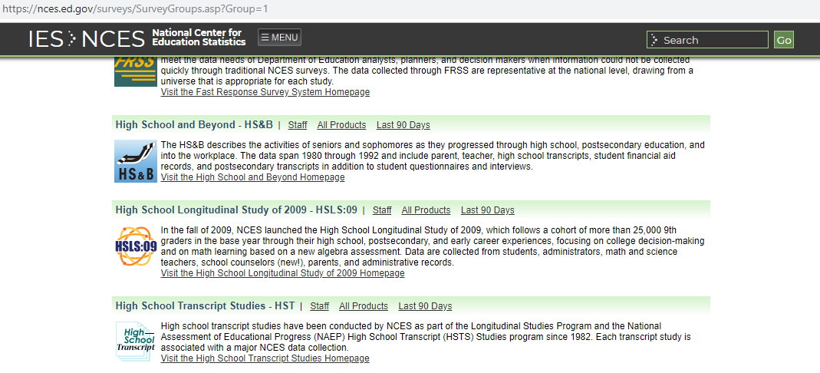


DATA SOURCE
HSLS (High School Longitudinal Study of 2009
NCES website & Page navigation:
https://nces.ed.gov/surveys/hsls09/

Slide 5

DATA SOURCE (CONT.)
High School Longitudinal Study of 2009 (HSLS:09) Features
a nationally representative study.
investigates the paths into and out of STEM fields, especially math field.
explores the educational and social experiences that affect paths changes.
surveys of students, their parents, math and science teachers, school administrators, and school counselors.

Slide 6
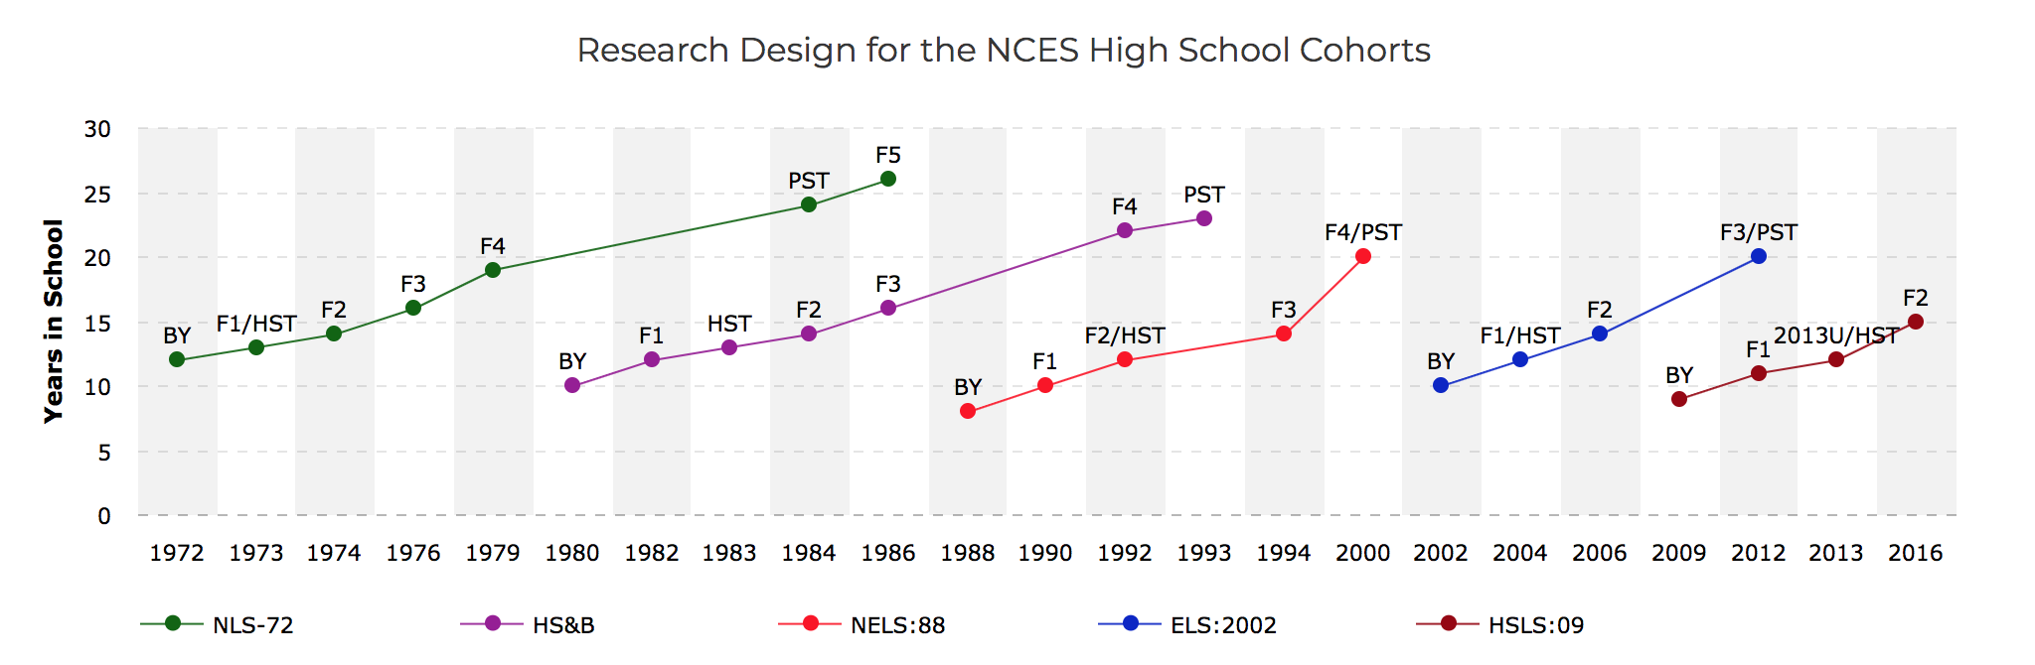
HSLS:09 DATA COLLECTION WAVES
HSLS:09 Data Collection Waves
BY: Base Year (2009): more than 23,000 ninth graders in 944 public and private schools.
F1: First Follow-up (2012): used in the current study.
2013U/HST: 2013 Update (2013):A postsecondary update provided the cohort’s college and major choices and plans.

Slide 7

Data Cleaning
Pick variables:
were acquired from student and parent self-report survey data from the first follow-up year of 2012.
Recode:
in order to align with other scales and keep items semantically in the positive direction
Missing values:
Listwise deletion

Slide 8
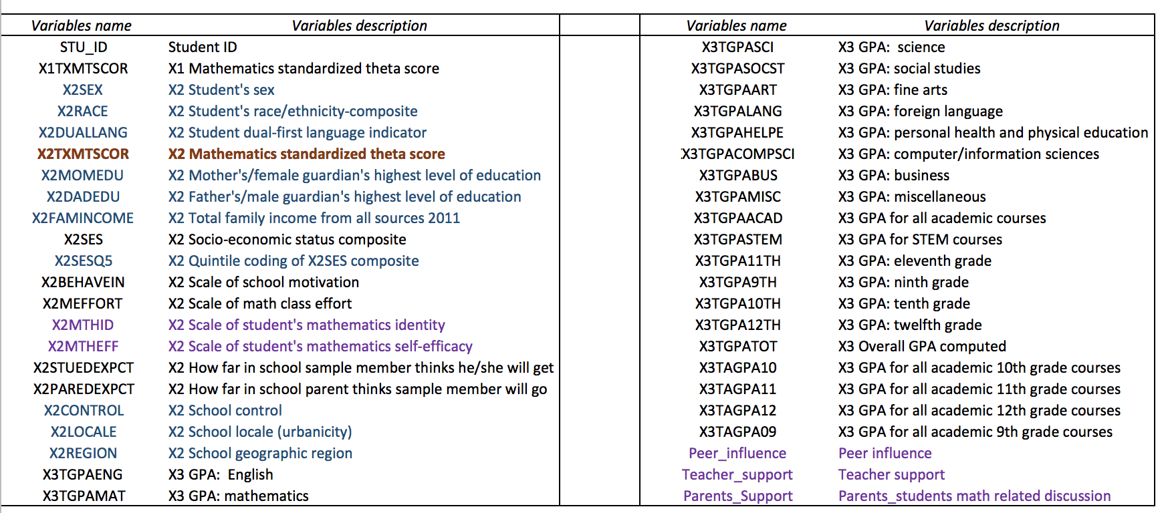
INITIAL VARIABLE EXPLORATION

Slide 9
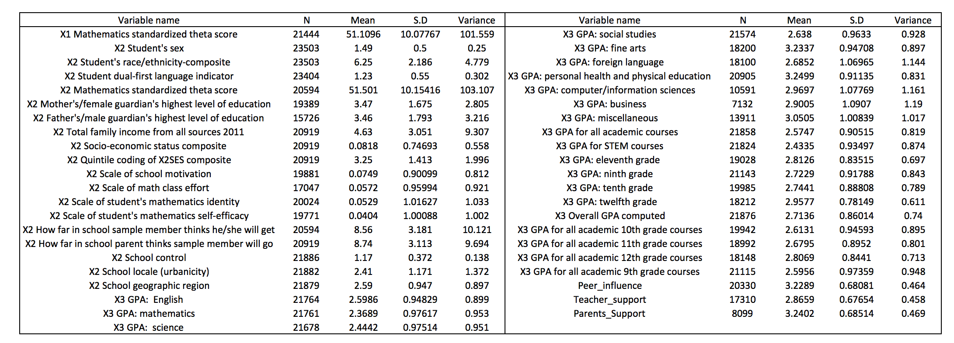
DESCRIPTIVE STATISTICS

Slide 10
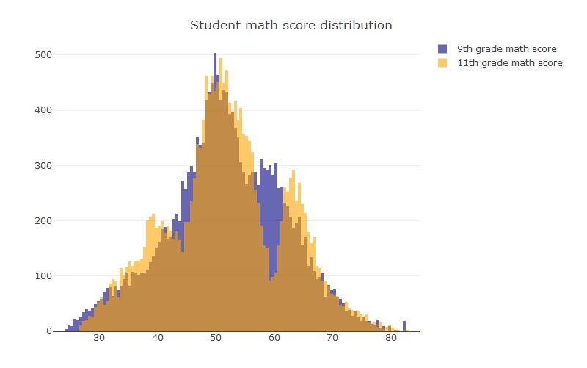
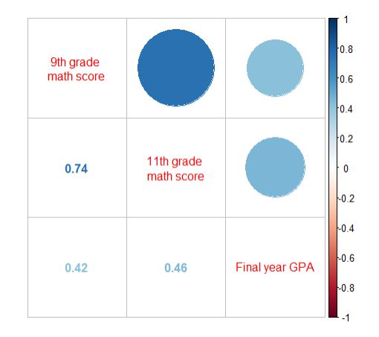
Test nature of the data
9th grade and 11th grade math score in data set.
test distribution.
check the correlation
11th grade math score has higher correlation to the final high school GPA result.

Slide 11
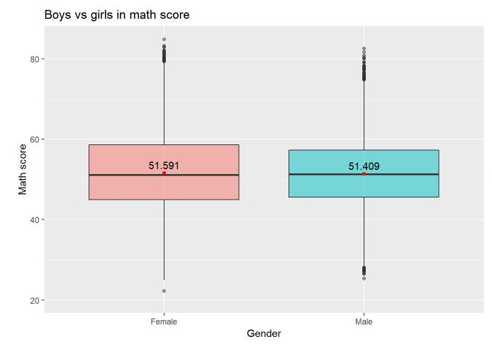
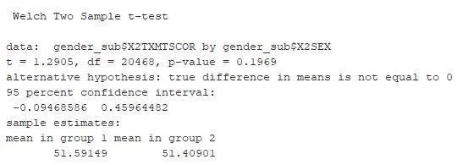
SMART: Does gender matters in high school students’ math performance?
H0: boys’ and girls’ math score means are the same.
H1: boys’ and girls’ math score means are not same.
P- value is 0.1969 larger than 0.05, so we fail to reject the null hypothesis.
Gender does not affect the student’s math score.
The math score spread for girls’ is larger than boys’.
SD: 10.62 9.66

Slide 12
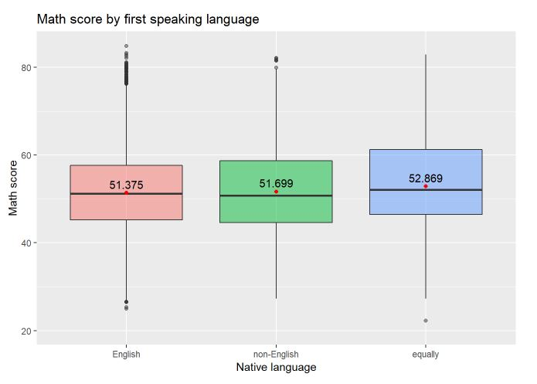
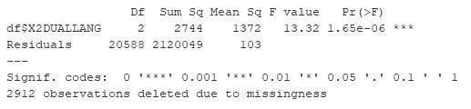
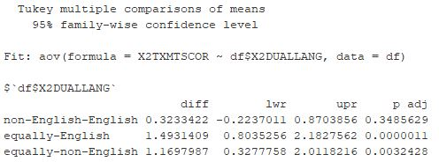
SMART: Does the first language influence student’s math performance?
H0: different first language group has the same mean in math score.
H1: different first language group has different mean in math score.
P- value is less than 0.05. We reject the null hypothesis.
At least one of the group‘s mean value is different from others.
Post hoc test revealed that non-English and English pair’s p-value > 0.05, they have equal mean value.
Dual-language group’s students have higher math mean score than other groups.

Slide 13
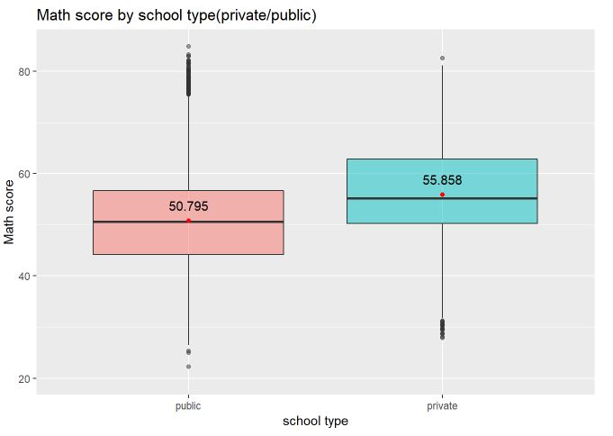
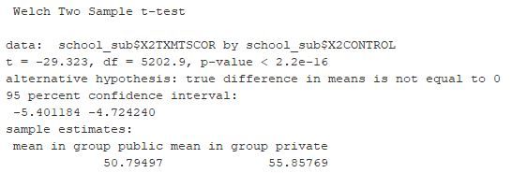
SMART: Does the students’ math performance differ by school background?
H0: private school and public school students’ math score have an equal mean value
H1: private school and public school students’ math score do not have an equal mean value
P- value is much less than 0.05, so we reject the null hypothesis.
The student’s math score in private school is higher than the student’s math score in public school.

Slide 14
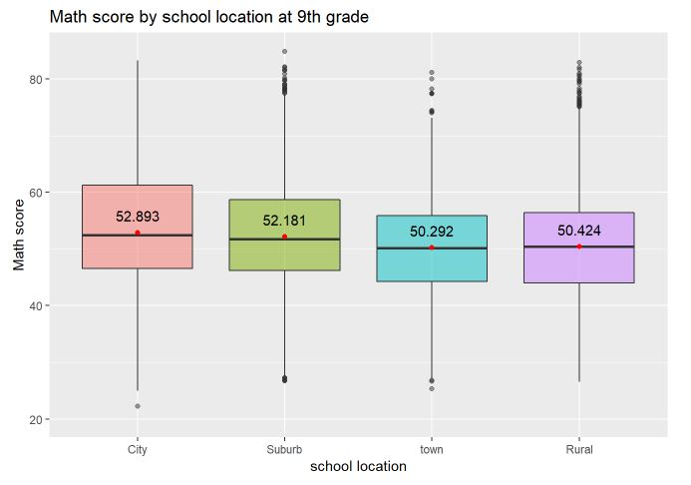
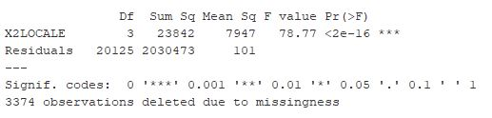
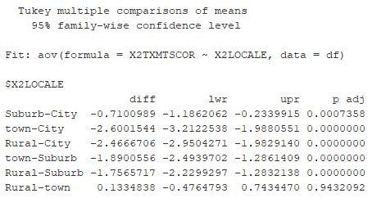
H0: students’ in different school locations have equal mean in math score.
H1: students’ in different school locations have different mean in math score.
P-value < 0.05, we reject the null hypothesis.
At least one of the school location groups’ math mean score is significantly different from others.
Post hoc test revealed there is no statistically significant difference between the town and rural groups (p >0.05).
City group has the highest mean score. Suburban group is the second high.

Slide 15
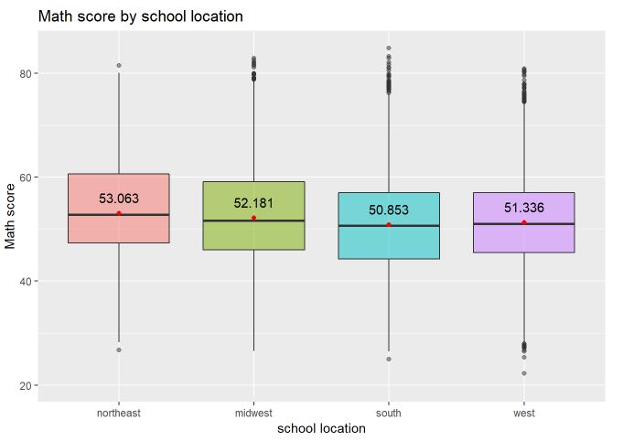
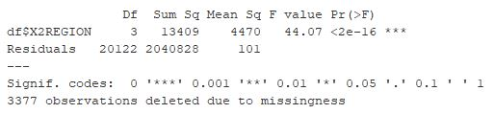
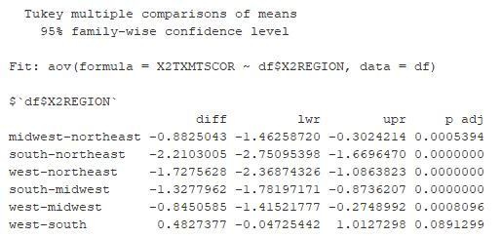
H0: student study at different geographical regions has equal mean in math score.
H1: student study at different geographical regions has different mean in math score.
p < 0.05, we reject the null hypothesis.
the mean of students math score is significantly different for at least one of the school geographic region groups.
Post hoc test reveals that the difference between the south and west region group is statistically significantly low.
West and south have an equal mean; midwest mean value is higher than the two groups. And the northeast is the highest.

Slide 16

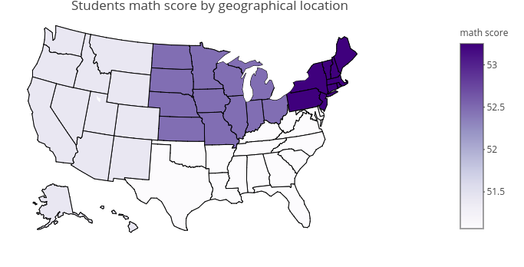
Math score geographical distribution
VS
US best college distribution
2019 US News best colleges
Northeast is the darkest. And also north east has the largest percentage of best colleges.

Slide 17
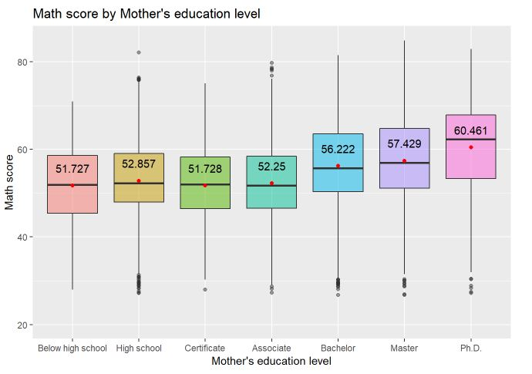
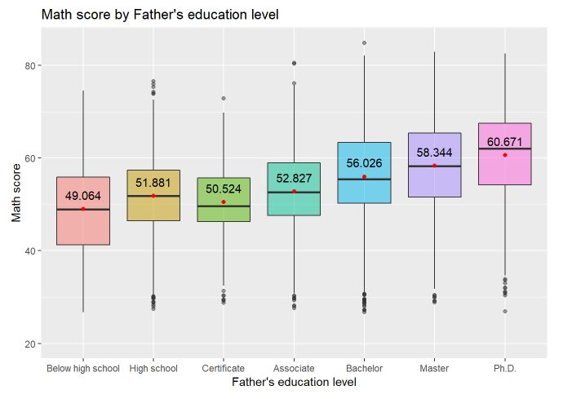
SMART: Does mother’s or father’s education level and family income level are related to students’ math score?
Students having parents with higher education level tends to have higher average maths score in high school.

Slide 18
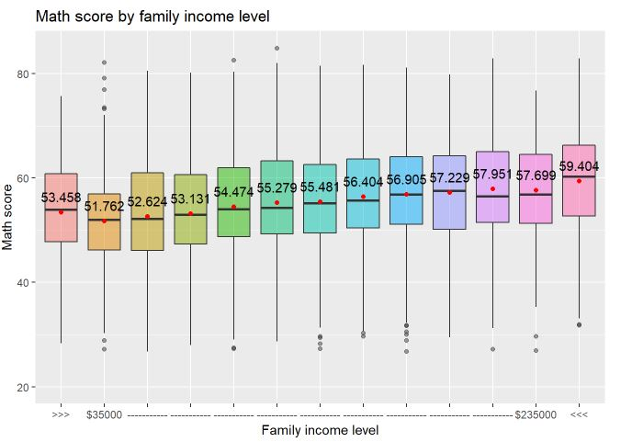
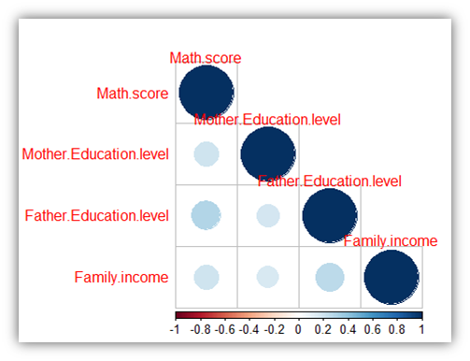
SMART: Does mother’s or father’s education level, family income level and SES related to students’ math score? (Conti.)
Mother education, father education, and family income level have correlation and influence on student’ math score.
In comparison, Father education level has larger impact on students’ math score.
Students having higher family income tends to have higher average maths score in high school.

Slide 19
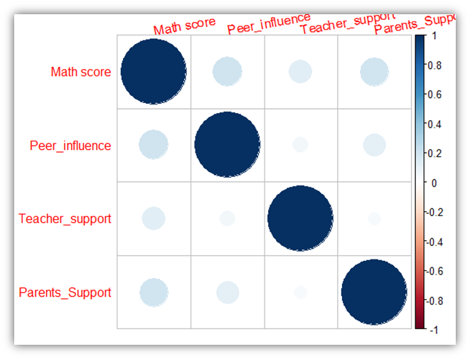
SMART: Peer, teacher and parents, which one affects students’ math score most?
Who Are ？
Peers: Classmates, their plans for entrance tests and admission into 4 year college degree.
Teachers: Teaching methodology.
Parents: Discussions and involvement with children for entrance exams and course selection.
Peers influence equal to parents support & are more correlated with student’s math score in comparison to teachers influence

Slide 20
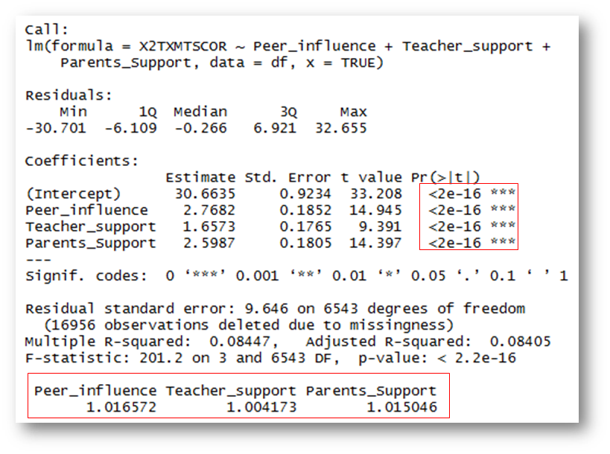
SMART: Peer, teacher and parents, which one affects students’ math score most? (Conti.)
•Good Fit Model with significant p-values p < 0.05.
•All three factors significantly influence students' math achievement, and the students' peer influence has highest significant regression weights, after controlling
•Variance Inflation Factor (VIF) value indicates multicollinearity.

Slide 21
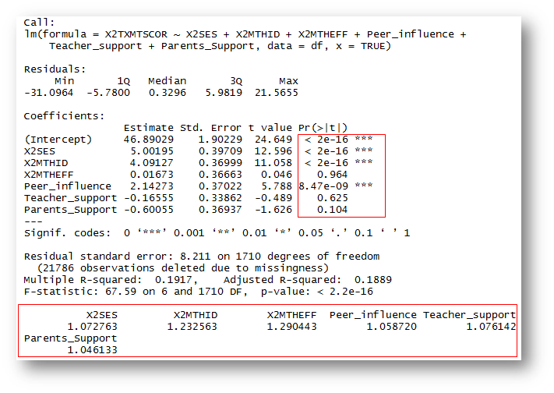

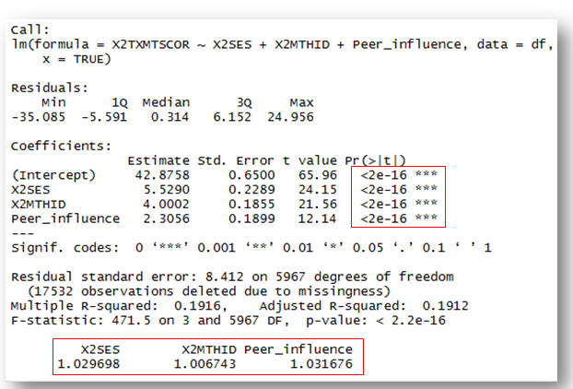
SMART: Which factor affects students’ math score most(SES, student math identity, other parties support)?
Good Fit Model with
p-value < 0.05 and no multicollinearity

Slide 22
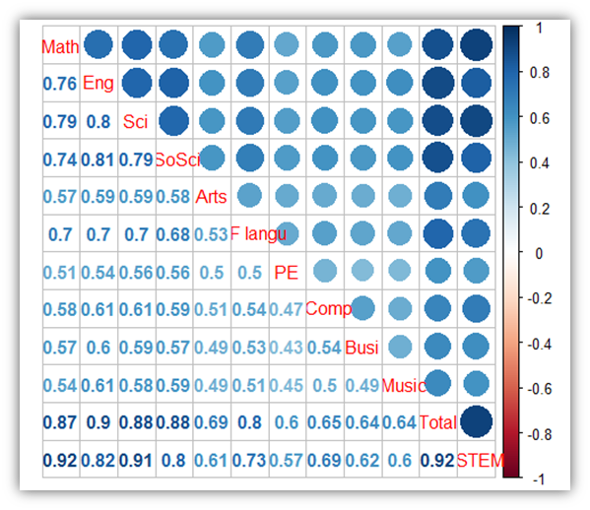
SMART: Is there any correlation between final year Math GPA and other final courses GPA?
As we can see through the correlation coefficients in the corrplot
Math GPA is highly correlated with STEM (Science, technology, engineering, and mathematics) score which is the college deciding scores.
The higher the math GPA, of the student the higher chance student get a high total score.
The top 4 highly correlated courses to Math are Science, English, Social Science and Foreign language.(On the contrary there are no computer science or business on the top)

Slide 23
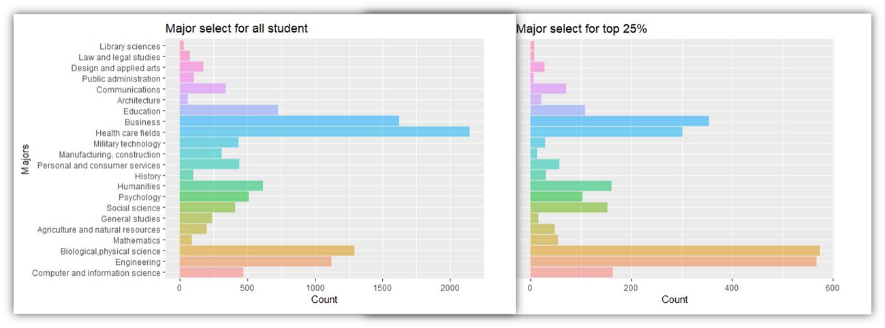
SMART: What is the most chosen major in college for students who are good at math in high school?
Student in high school pursue further education: Business ,Healthcare field.
Students with top 25 % maths score pursue further education: Biological, Physical sciences & Engineering field.

Slide 24
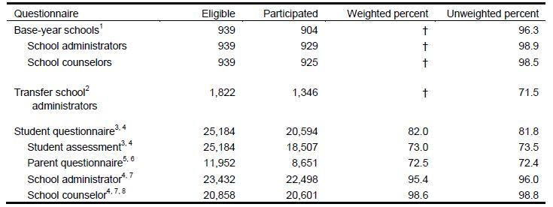
WHAT ARE THE LIMITATIONS OF THE DATASET?
The study is designed upon follow up questionnaire and interactions with :
Students
Parents
Teachers
Counselors
School Administrators
However, failure to answer those questionnaires or incorrect answering could lead to data inaccuracy or if there could be some missing entries in the dataset, it would impact overall analysis.

Slide 25
CONCLUSION
Summary:
Gender does not affect the student’s math performance.
Language makes a difference in the math performance.
Student’s math performance in private school is always higher than the student’s math performance in public school.
Student’s school location has correlation with the student’s math performance.
Student’s family socioeconomic status has great impact on students math performance:
1. Student whose father or mother has a higher education level tends to have a
higher math performance in the high school.
2. Father education level has a larger impact on students’ math performance.
3. Student whose family income level is higher tends to have a higher math
performance in high school.
Peer’s support, socioeconomic status and student’s own motivation are most important factor influence student’s math performance.
Student’s high school math performance influences the decision for postsecondary options.
The dataset focuses on how students plan and make decisions about postsecondary options.
There are many outcomes that we can derive from the analysis of the effects of different factors on high school student's math achievement, and how does it affect their postsecondary study. We can conclude that these factors affect the achievements of the students and their future choices greatly.
Future work:
Use the whole dataset by collecting more observations and features for other classes also with less missing values and limitations.

Slide 26


Slide 27
REFERENCE
Chaudhry.M.(2015), College Success Starts In Math Class, Forbes. Access at <https://www.forbes.com/sites/schoolboard/2015/05/08/college-success-starts-in-8th-grade-math-class/#3d775c17248e>
Abadi.M and Kiersz.A(2018), Exactly which states are in the Northeast, Midwest, South, and West, according to the US government, Business insider. Access at <https://www.businessinsider.com/united-states-regions-new-england-midwest-south-2018-4#and-west-south-central-includes-the-western-most-states-in-the-south-10>
Math milestones: The critical role of math achievement in student success, Renaissance. Access at <https://www.renaissance.com/2018/03/22/blog-math-milestones-critical-role-math-achievement-student-success/>
Boyington.B.(2018),, Where to Find the 2019 U.S. News Best Colleges,U.S.News. Access at <https://www.usnews.com/education/best-colleges/articles/2018-09-11/where-to-find-the-2019-us-news-best-colleges>

